Slide 1
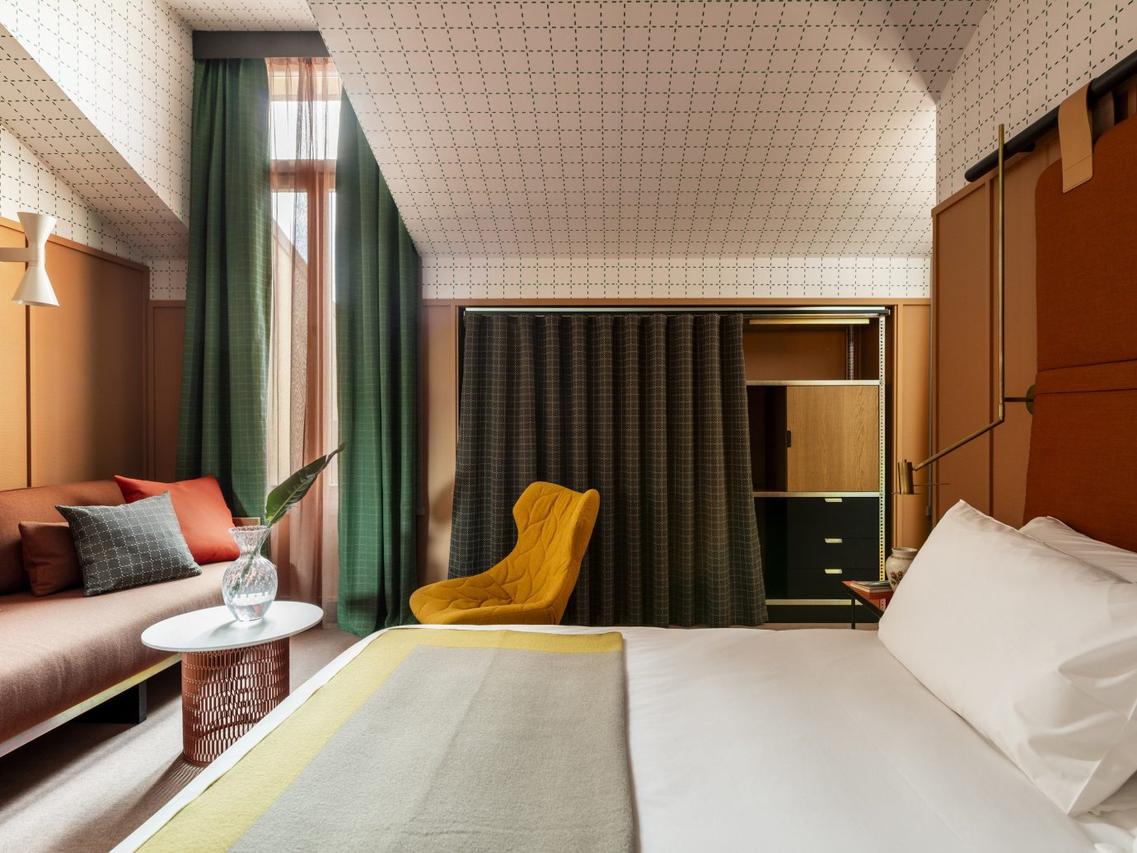
Predicting Hotel Booking Cancelation
HIMAWAN ICHWANA

Slide 2
Project Outline
Project
Background
Problem
Data
Data Source & Data Overview
Data Preparation
EDA and Visualization
Model
First Glance Model
SMOTE
Baseline Model
Hyperparameter Tuning
Feature Engineering
Goals

Slide 3

The hospitality industry in portugal is a big industry that delivered a revenue of $3.6 billion in 2017, with a 12.1% year-over-year increase in overnight stays by international visitors to 37.2 million according to the portugal's national institute of statistics. The ascension in the number of visitors cannot be separated from the easier access to book a room. Over the years, the hotel industry has changed with a majority of bookings now made through third parties such as booking.com. But nearly 40 percent of on-the-books revenue is canceled before arrival, according to a study conducted by d-edge hospitality solutions. The average cancelation rate in 2014 was 32.9 percent and increased to 39.6 percent in 2018. It reached a high of 41.3 percent in 2017 . this increase in booking cancellation makes it harder for hotels to accurately forecast, leading to non-optimized occupancy and revenue loss. Being able to predict hotel booking cancellations is relevant for many components in the hospitality industry. For example, in room inventory management, predicting cancellations allows to produce accurate dynamic pricing models for hotel rooms. Therefore, if we can predict if a guest would cancel a reservation, hotels could contact guests that most likely to cancel to confirm more efficiently and to resell the room to optimize revenues.
Project BACKGROUND & Problem
Source :
https://www.hotelnewsnow.com/articles/286991/portugals-tourism-boom-sparks-economics-hotel-growth
https://www.hotelmanagement.net/tech/study-cancelation-rate-at-40-as-otas-push-free-change-policy
https://www.d-edge.com/how-online-hotel-distribution-is-changing-in-europe

Slide 4

Project Goals
GOALS
Why being able to predict hotel booking cancelation are beneficial ?
Understand and gain insight from hotel booking cancelation dataset
To build a model able to classify a booking as canceled or not canceled.
Avoid non-optimized occupancy and revenue loss due to the high number of cancelation
Helping marketing team to set a proper target for the hotels
Be able to maximize overbooking method

Slide 5

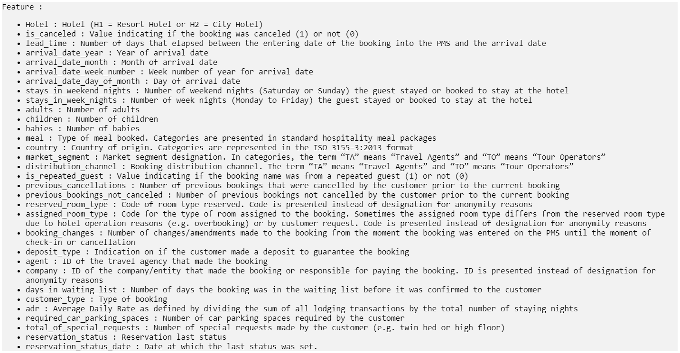
Data Source & Data Overview (i)
https://www.kaggle.com/jessemostipak/hotel-booking-demand
Original data : Extraction from hotels’ Property Management System (PMS) SQL databases (https://www.sciencedirect.com/science/article/pii/S2352340918315191#bib5)

Slide 6
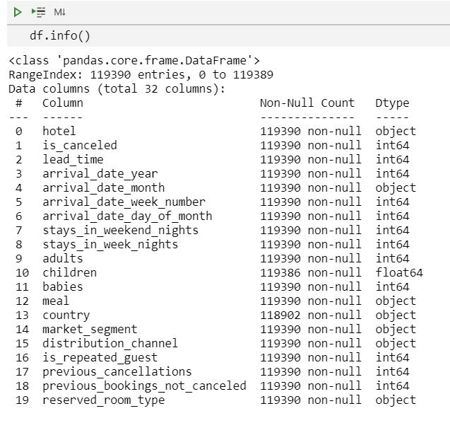
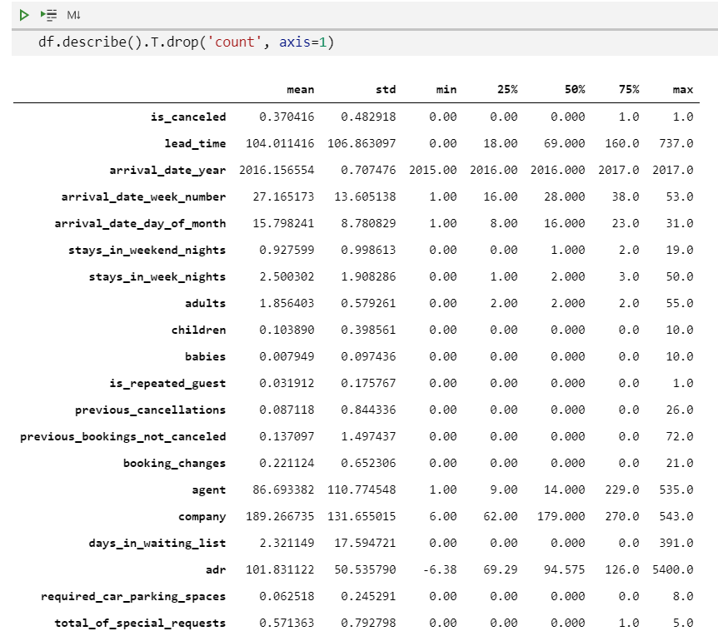
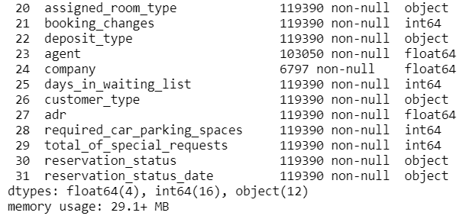
Data Overview (iI)

Slide 7

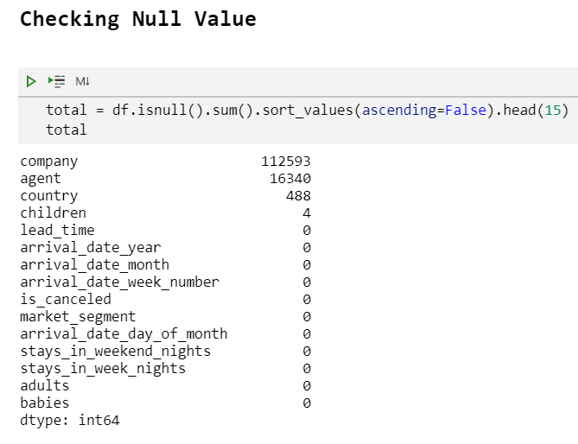
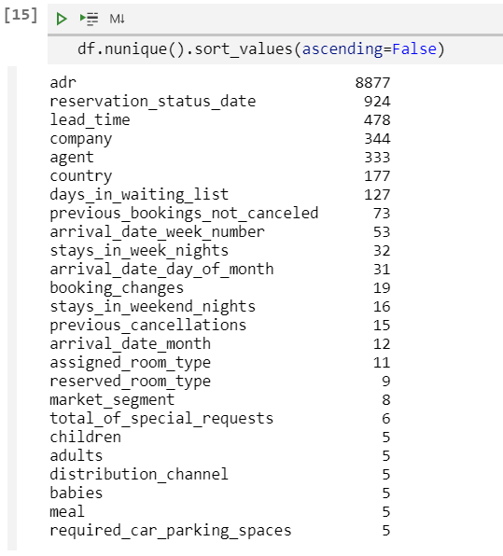
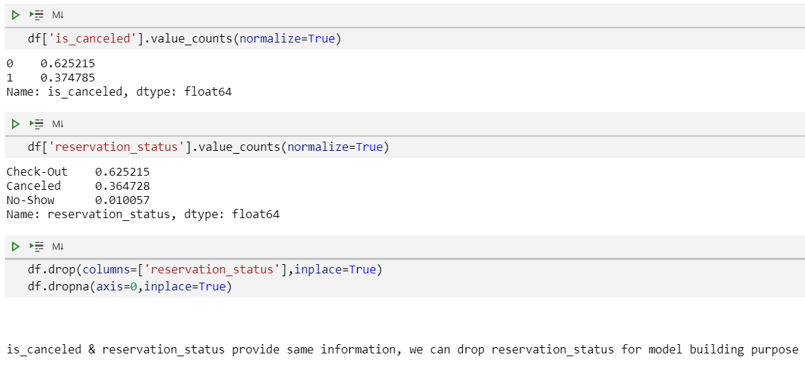
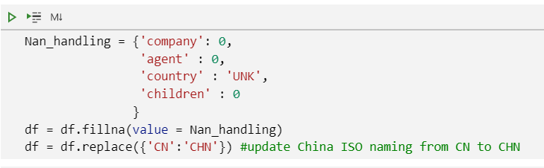
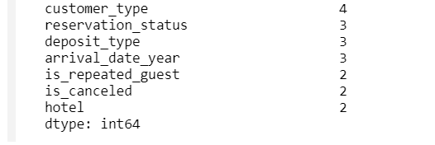
Data Preparation and Handling Missing Values

Slide 8

EDA & DATA visualization

Slide 9
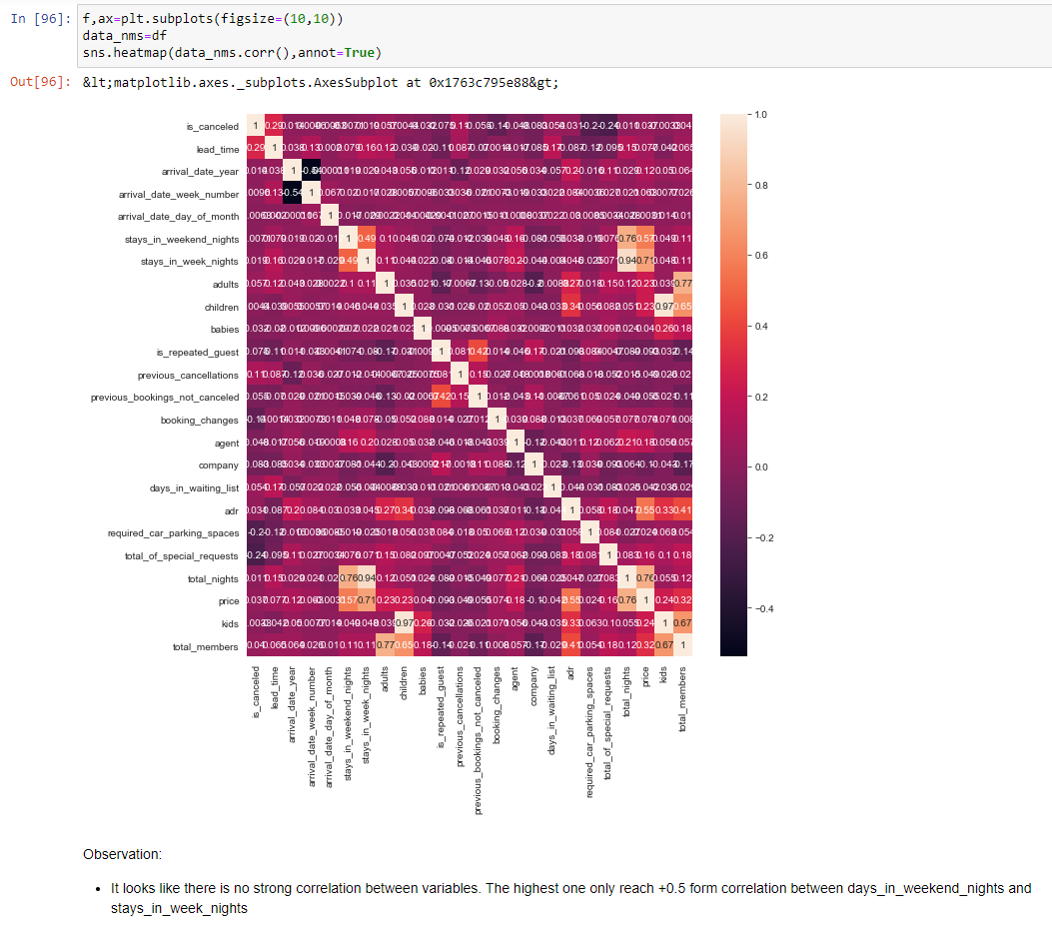
Correlation between Features

Slide 10
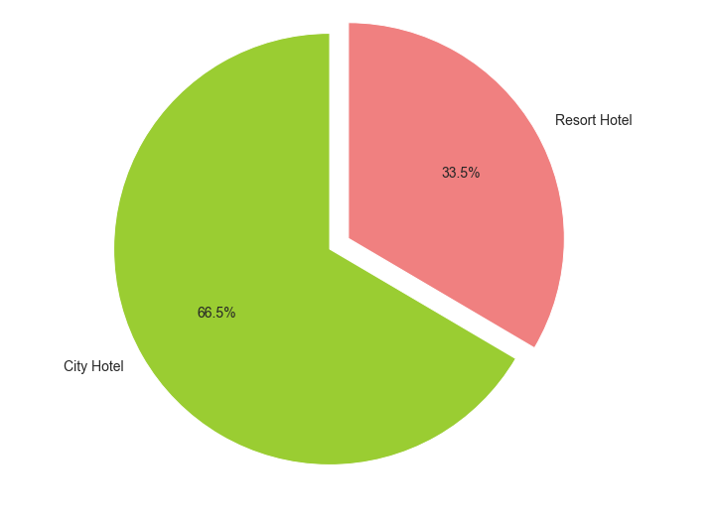
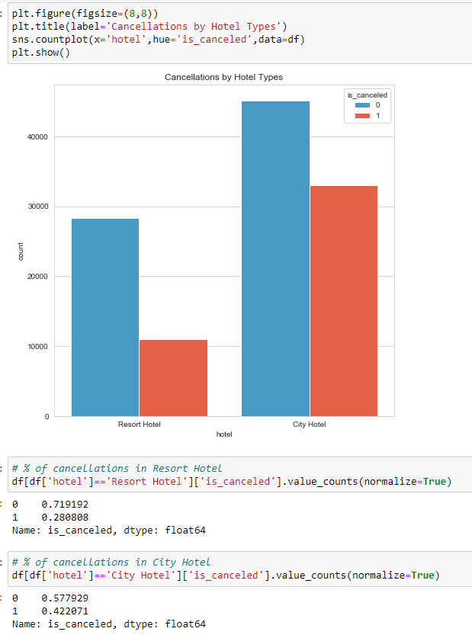
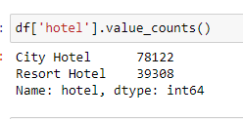
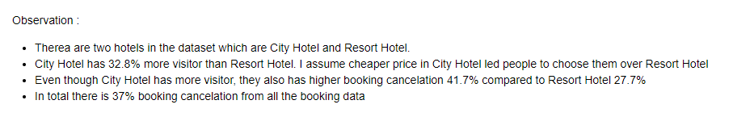
Which hotel has more cancelations?

Slide 11
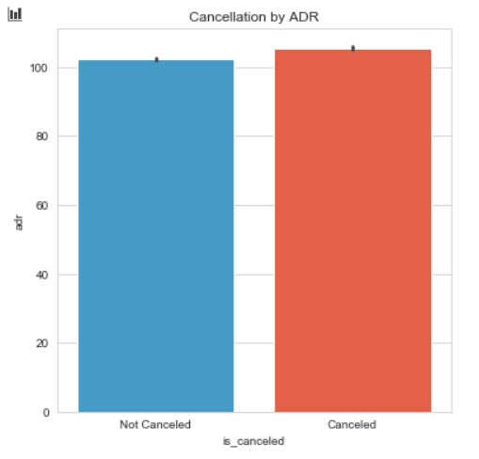
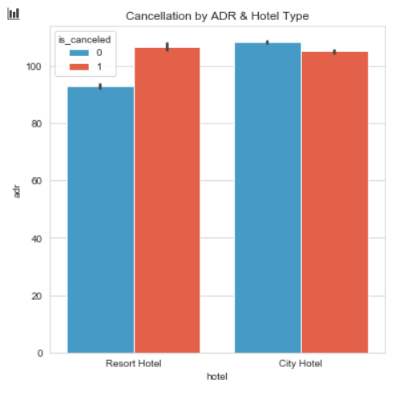
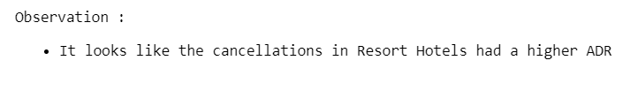
Which hotel has more cancelations?

Slide 12
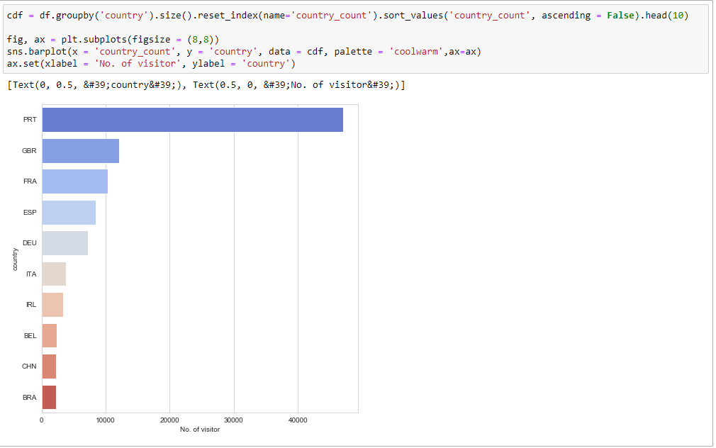
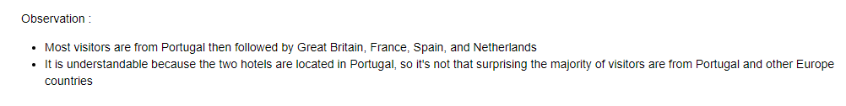
Where do the visitors come from?

Slide 13
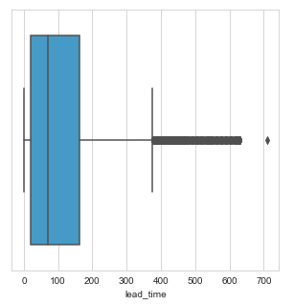
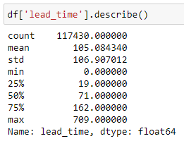
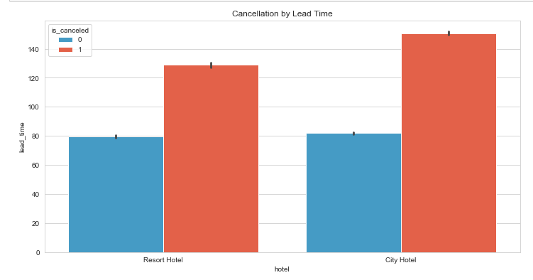
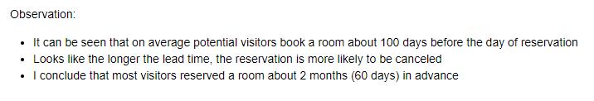
Does lead time affect cancelation?

Slide 14
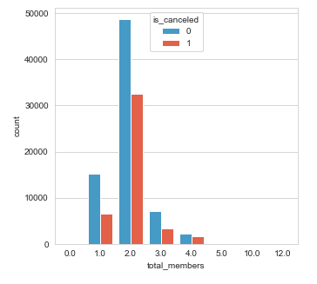
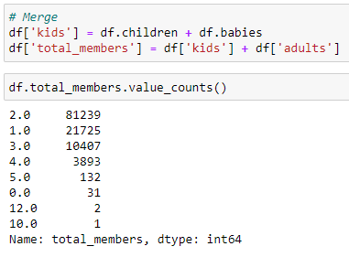
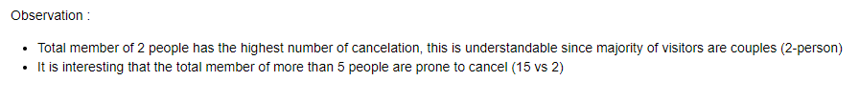
Does total member affect cancelation?

Slide 15
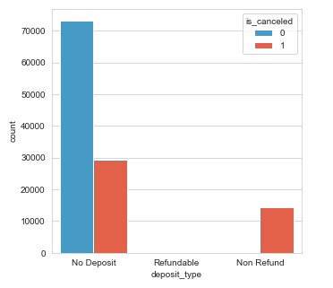
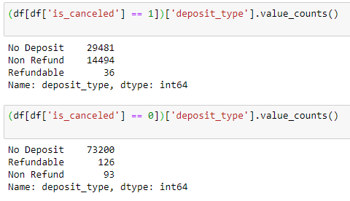
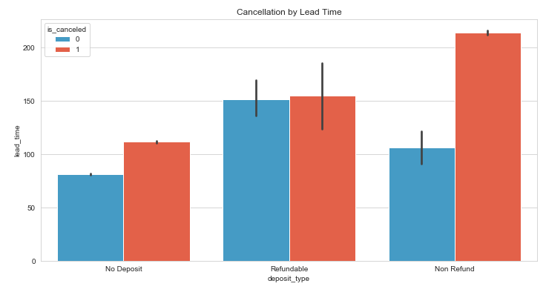
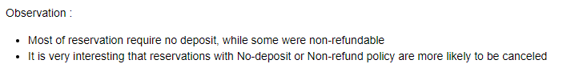
Does deposit type affect cancelation?

Slide 16
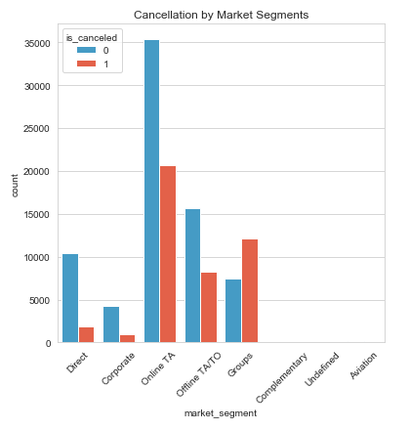
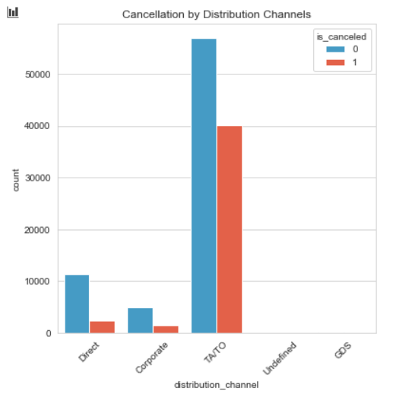
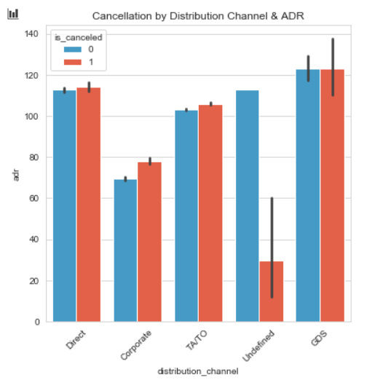
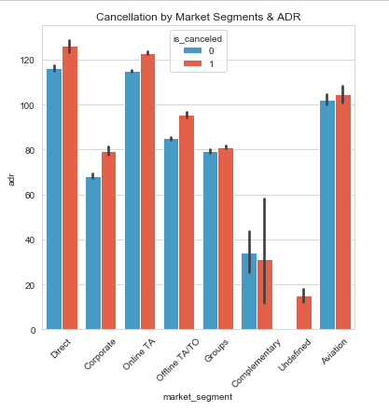
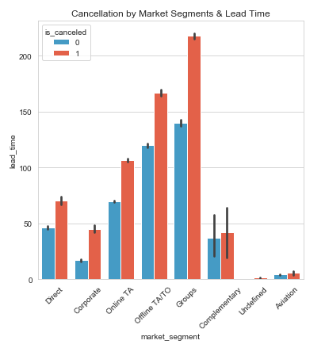
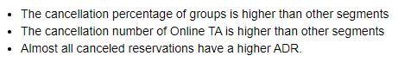
Do Market Segment & Distribution Channel affect cancelation?

Slide 17
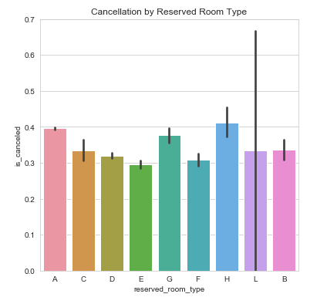
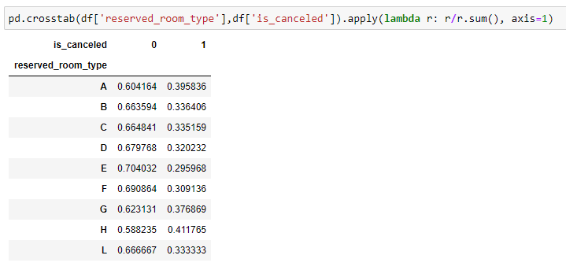
Which are types of room that have the highest precentage of being canceled?

Slide 18
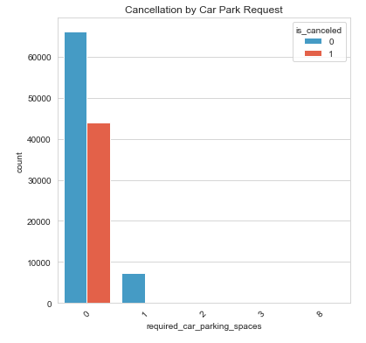
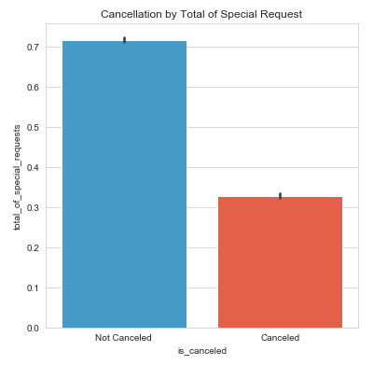
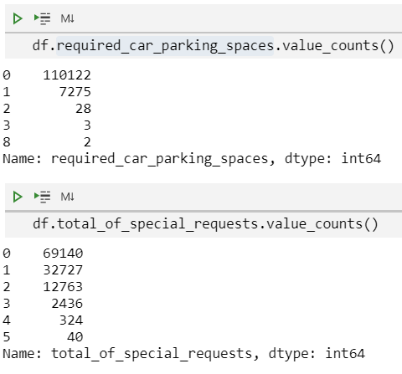
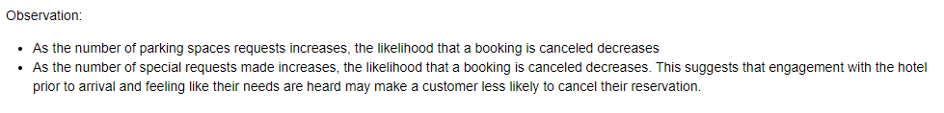
Does special request including car parking space affect cancelation?

Slide 19
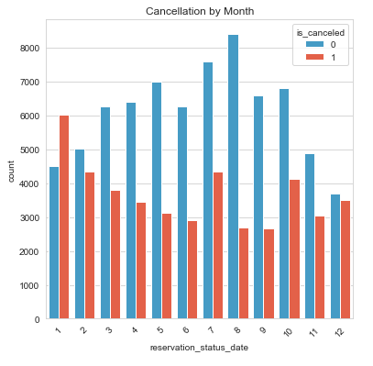
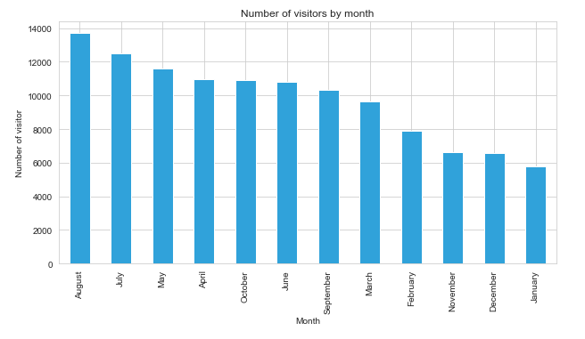
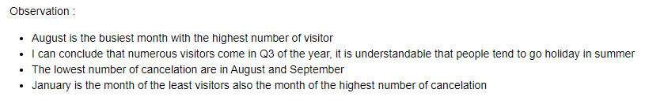
What is the busiest month and which month whose the number of cancelation is the highest?

Slide 20
Feature engineering
Looking for high correlation between features
Aggregating columns
Choosing the necessary features

Slide 21
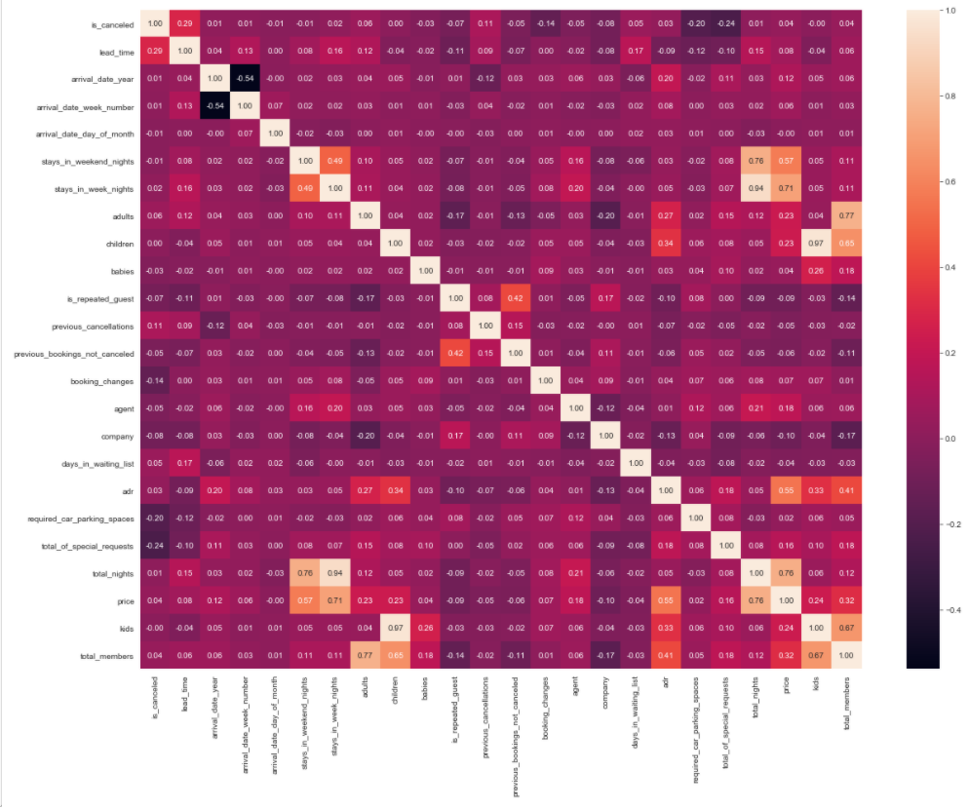
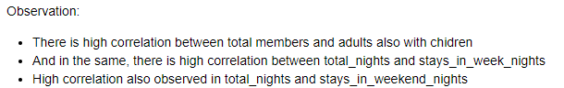
Looking for high correlation after aggregating some columns

Slide 22
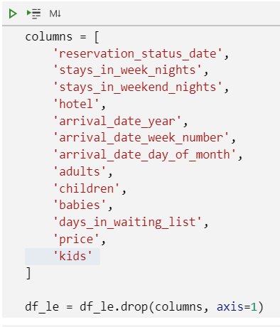
Choosing the necessary features

Slide 23

Modelling

Slide 24
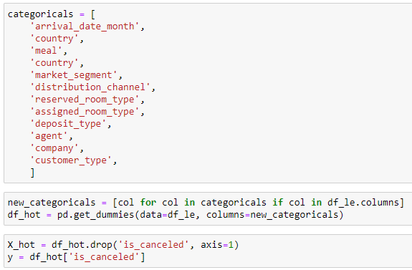


Dummy Variable & First Glance of Model

Slide 25


SMOTE

Slide 26


Baseline Model (Logistic Regression)

Slide 27


Baseline Model (Naive Bayes)

Slide 28


Baseline Model (KNN)

Slide 29


Baseline Model (Random Forest)

Slide 30


Baseline Model (XGBoost)

Slide 31


Hyperparameter Tuning for Random Forest

Slide 32



Hyperparameter Tuning for XGBoost

Slide 33

Summary Modelling

Slide 34


User Input Page

Slide 35

Result Page

Slide 36
Business summary
From EDA we observed that a majority of the hotel customers were from people who book a room from Online TA, offline TA and groups of people. Those Online Travel Agengies (OTA) have transformed cancellation policies from a footnote on the booking confirmation to the basis of entire OTA marketing campaigns, designed specifically to position agencies as the most risk-free option for guests. Average lead times tend to be longer on OTAs. This is because their message to the consumer is to book now, even if they’re not sure. They encourage guests to reserve a room even when they’re still in the ‘looking’ or ‘dreaming’ stages of the buying process, with the message that they can take advantage of cancellation policies later. So to deal with this problem, these following suggestion may be applied :
Consider more restrictive cancellation policies on channels with larger numbers of cancellations
Sweeten the deal for booking direct, to build relationship and easily monitor with the customers
The bookings trends, combined with the booking cancellation predictions, can help hotels better forecast their occupancy rates in the different months, allowing for better cost control.
Maximazing the overbooking method to reduce loss of revenue
More restricted policy for group booking, such as increasing deposit value up to 50 – 70%, reduce the lead time and get in touch with the representative of the group regurarly
Expand customers to other countries outside Portugal. By diversifying customer mix and offerings would better protect hotels from unsystematic risks.

Slide 37
CONCLUSION
XGBoost baseline gives the best accuracy result
SMOTE was performed to handle imbalanced dataset
After performed hyeperparameter tuning, XGBoost model gives a better result but the model become overfitting. Due to limited of time and laptop performance, I was unable to perform more hyperparameter tuning with more parameters.
Machine Learning Model

Slide 38
THANK YOU

